Slide 1
Worksafenb taskforce: stakeholder focus group - employers
NB Chambers of Commerce
Presented by Krista Ross,
Fredericton Chamber of Commerce
24 August 2017

Slide 2
To Remain Sustainable, Workers Compensation Has to Work for Everyone
Workers’ compensation must provide fair and adequate compensation to injured workers while not damaging the competitiveness of NB businesses
Cooperation between workers and employers have made workplaces safer → leading to steadily decreasing premiums since 2010
Lower injury rates (and premiums) mean that employers can reinvest in the business – create jobs, add hours, etc.

Slide 3
Loss of control
Business is nervous that there’s no mechanism to get costs to the system back under control
Workplaces are becoming safer (where employers have some control/influence), but this matters much less vis-à-vis the WSNB rate since 2015 legislative changes
*dropping rates from 2010 to 2015
5 individual appeals alone drove $87M in cost increases

Slide 4
The rate is half of the equation
The cost to business is not only the rate.
The rate may still be lower than in the early 1990s, but assessable payroll has increased by more than 100% since that time.
Actual cost to business has risen 30% during that same period.

Slide 5
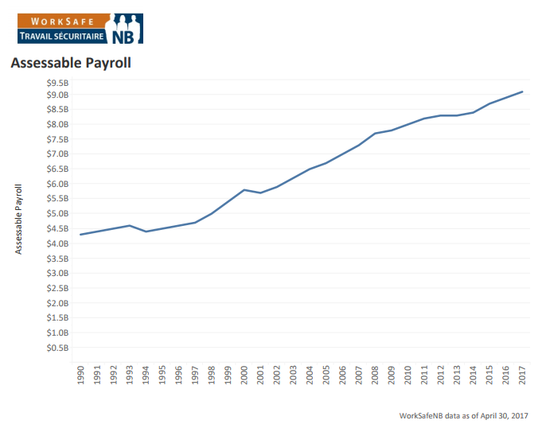
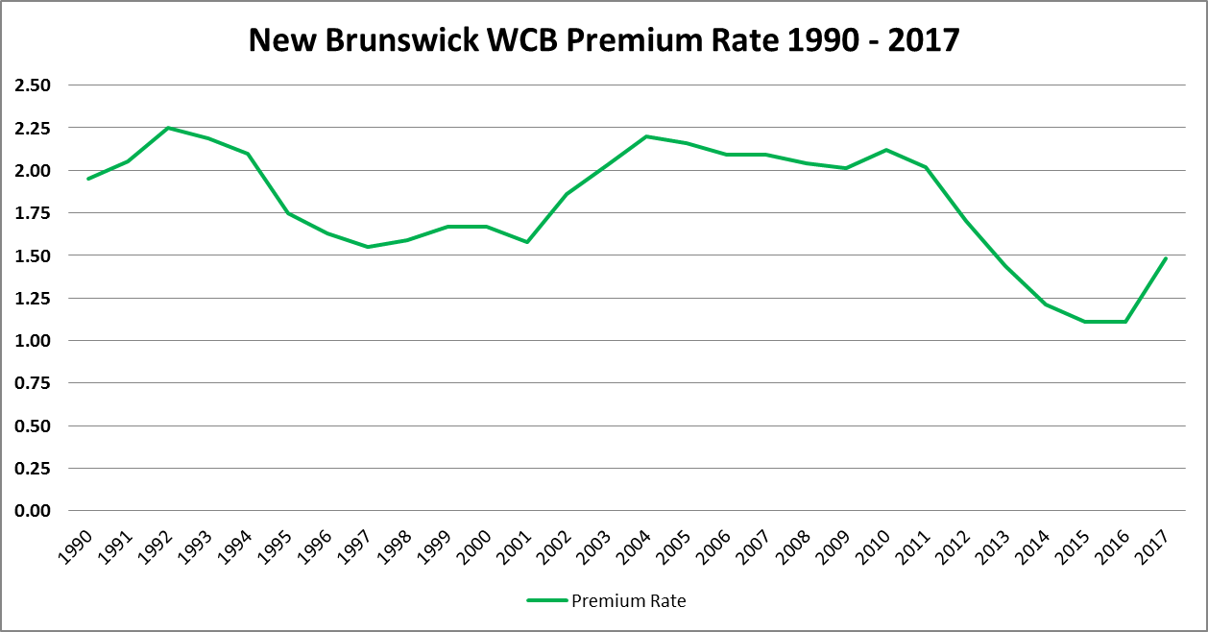
New Brunswick Assessable Payroll – 1990 - 2017
$9.1 B
$4.47 B
$2.25
$1.48

Slide 6
New Brunswick Assessable Payroll and Rate Comparison
Year | Rate | Assessable payroll | $ paid in Assessments
1992 * | $2.25 | $4,446,000,000 | $101,250,000
2017 | $1.48 | $9,100,000,000 ** | $131,000,000
30% Increase
* 1992 was the highest premium paid in the past 30 years
** Estimated based on WorkSafeNB projections

Slide 7
Self-Insured Employers
An alarming trend with self-insured employers – primarily the Government of New Brunswick
Frequency rate more than 2.5 times that of assessed employers
Concerned about cost to the Province coffers, increased debt

Slide 8
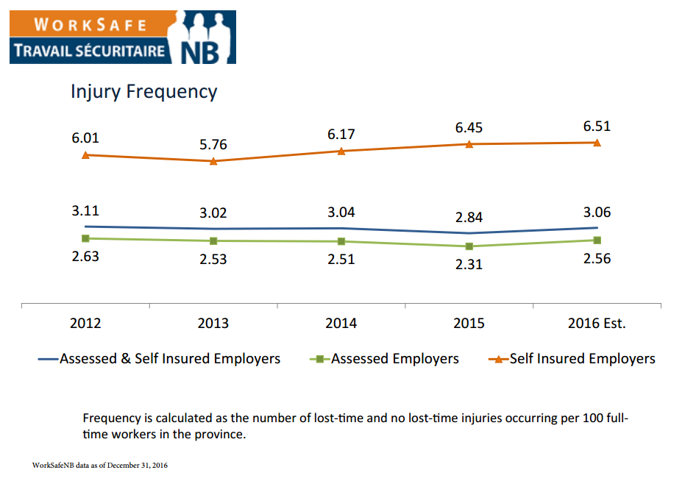
Frequency rate for self insured is more than 2.5 times assessed employers

Slide 9
Process and Procedure Issues
WCAT superseding/setting board policy with decisions
In our view, the WSNB board is in the best position to set policy – they have the fullest perspective on the system
Impact on employees/employers; history of maintaining a sustainable system; reasoning behind policies
WCAT interpreting legislation and policy with no regard for the sustainability of the system
Timing - setting the rate in the fall leaves employers little time to prepare
Which is more important now than ever given the huge increases in 2017 and pending in 2018.

Slide 10
Escalating Business Costs
WSNB premiums just one of the increasing costs to business in NB
Since 2015:
Combined with minimal economic growth over the past decade, SMEs are tapped out
No money left to reinvest in business, create jobs, etc
Gas & diesel tax | EI rate
Property tax | Proposed federal tax planning changes (2018)
Land transfer tax | WorkSafeNB (2017 & 2018)
Income tax | Carbon tax (2018)
Minimum wage | Statutory holiday (2018)
HST | CPP (2019)

